Slide 1
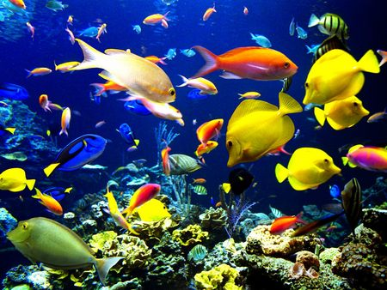
Fish!

Slide 2
Invertebrates and Vertebrates
Which came first?
Why?

Slide 3
Vertebrates and Invertebrates
The first animals were invertebrates
The first animals with backbones, or vertebrates, were fish

Slide 4
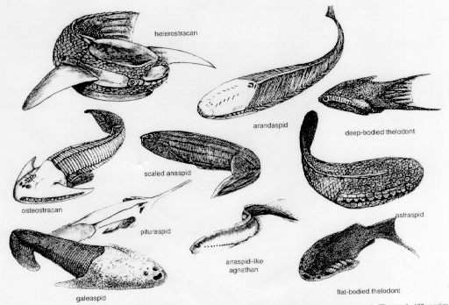
Ostracoderms

Slide 5
Ostracoderms
The earliest fish on Earth are called Ostracoderms
Ostracoderms were jawless fish
    They had no jaws!
    What do you think your life would be like if you did not have a jaw?
      How do you think you would eat without a jaw?

Slide 6
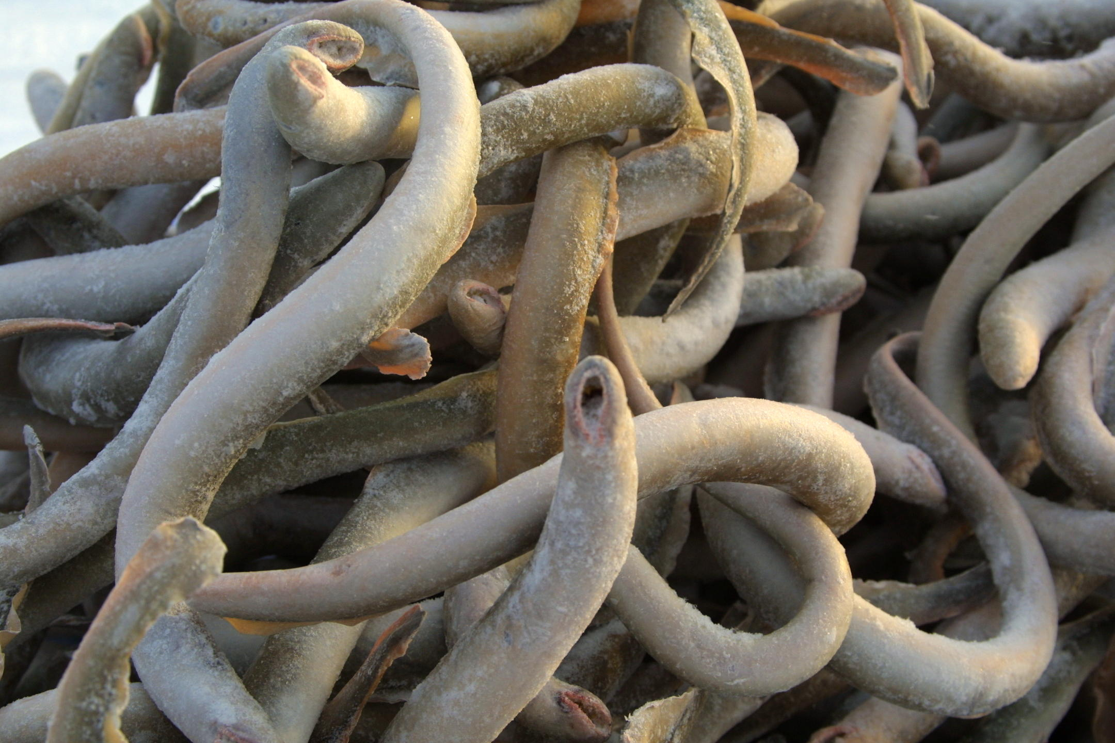

Slide 7
Lampreys
How do you think lampreys eat?

Slide 8
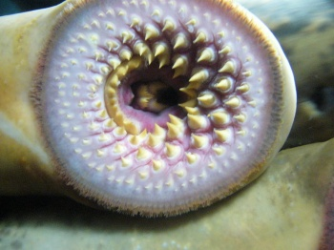

Slide 9
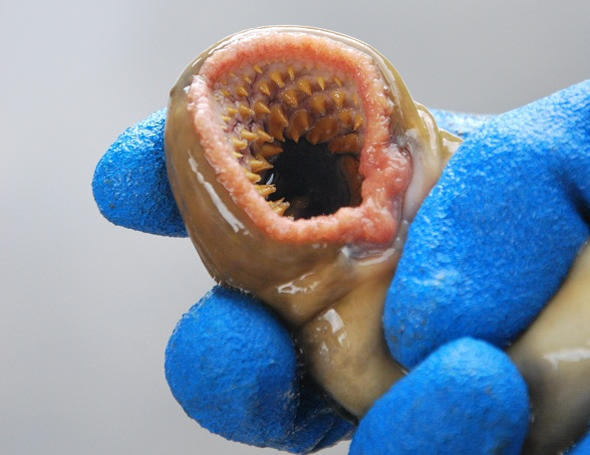

Slide 10
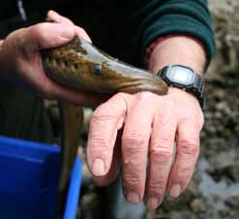

Slide 11
Jawless Fish
The only jawless fish alive today are:
Lampreys
Hagfish

Slide 12
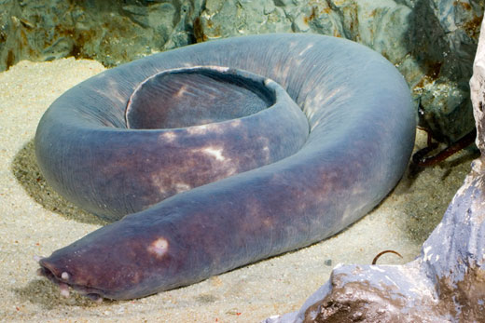

Slide 13
Jawed Fish
Over millions of years, some jawless fish developed jaws.
These fish are called jawed fish.
There are 2 main groups of jawed fish….

Slide 14
Jawed Fish
One group of jawed fish have skeletons made mostly of cartilage.
Touch the outside of your ear.
    What does it feel like?

Slide 15
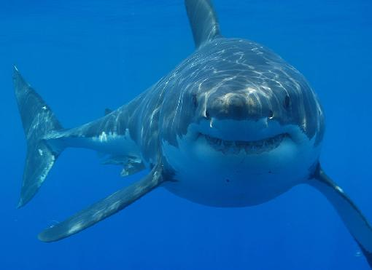

Slide 16
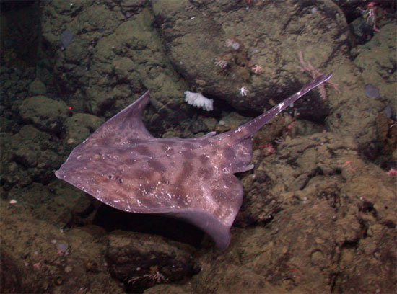

Slide 17
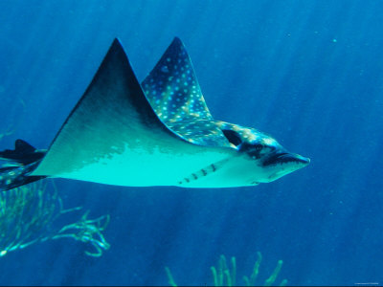

Slide 18
Jawed Fish
The second type of jawed fish are called bony fish
Do you think most fish today are fish with skeletons made mostly of cartilage or skeletons made mostly of bones?

Slide 19
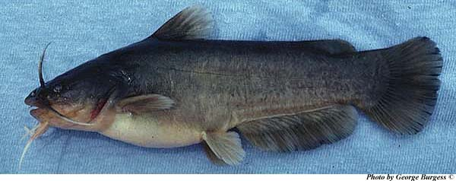
Catfish

Slide 20
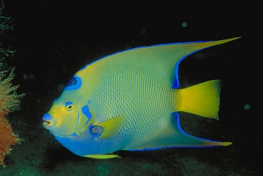

Slide 21
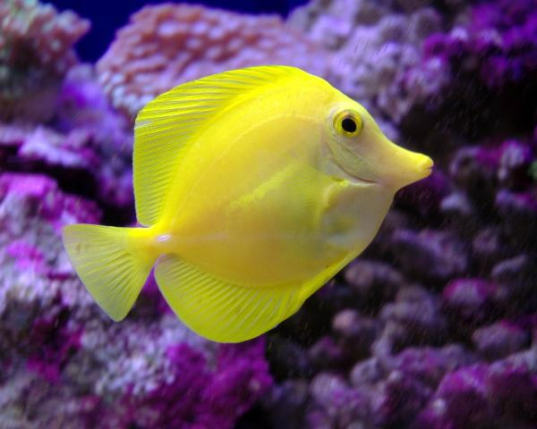

Slide 22
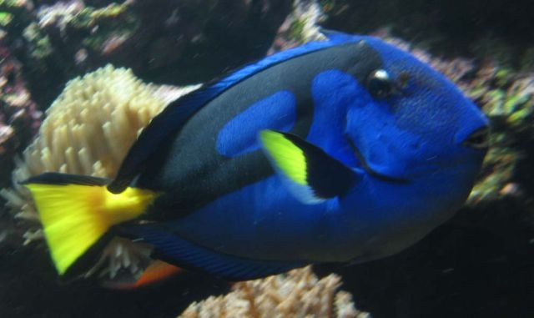

Slide 23
Modern Fish
The fish that exist today are called modern fish.
The first modern fish appeared on Earth around 200 million years ago.
There are almost 25,000 known species of fish.

Slide 24
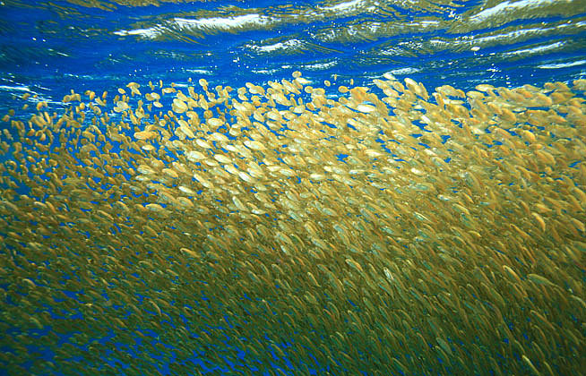

Slide 25
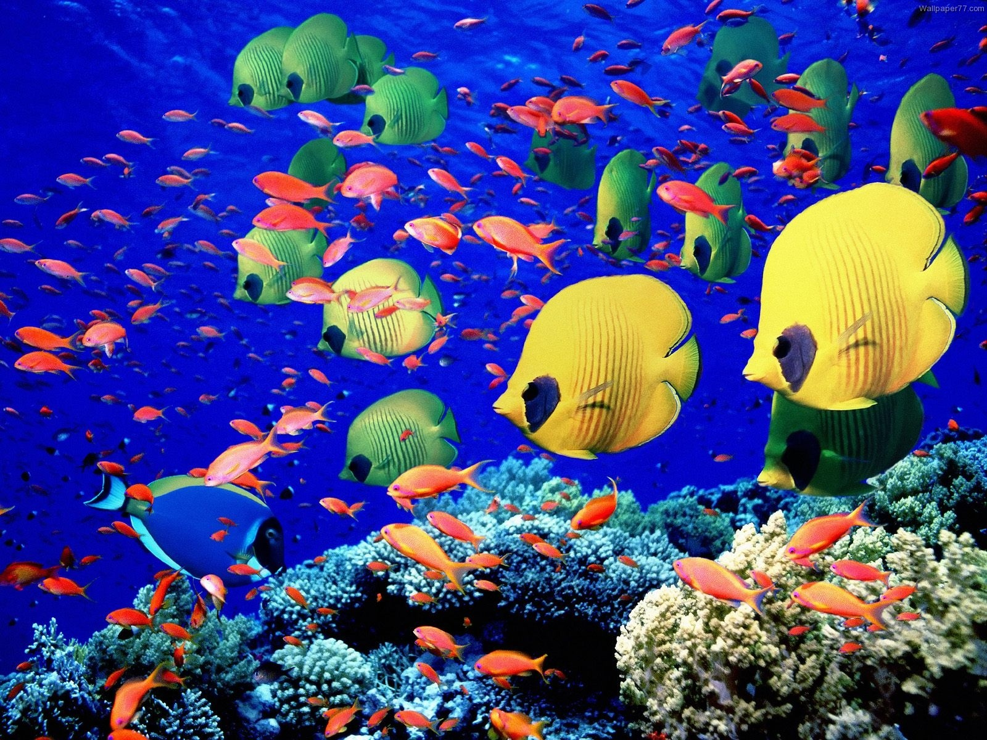

Slide 26
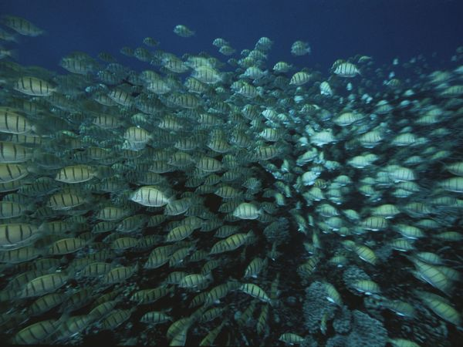

Slide 27
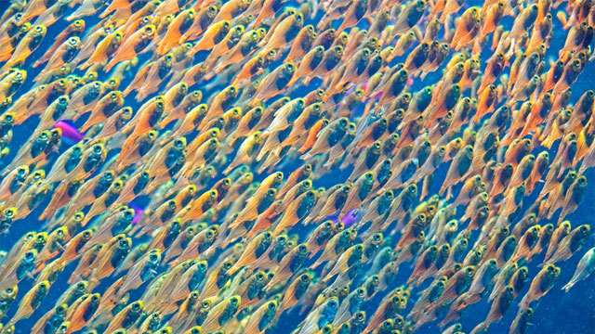

Slide 28
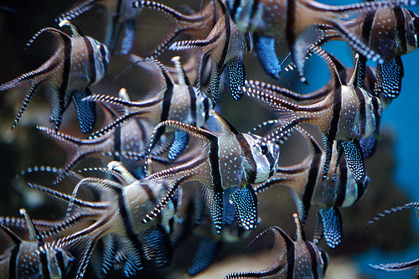

Slide 29
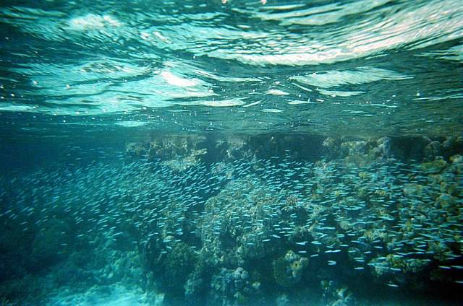

Slide 30
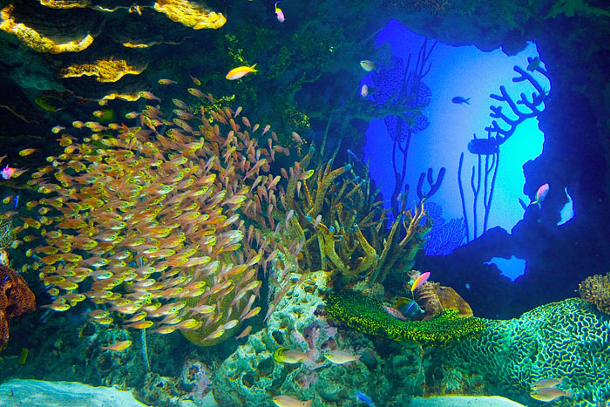

Slide 31

Enjoy your FISH sticks for lunch!! ☺

