Slide 1
Theories of Career Development
Developmental Theories

Slide 2
Developmental Theories
Developmental theorists see change as sequential, cumulative, rational, and hierarchical in nature.
  Happens across stages in a predictable way.
  Progression through these stages affects eventual career choice.

Slide 3
Eli Ginzberg
Theory of Career Development (1951)
Irreversible process that occurs over a 10 to 15 year span
Series of compromises between wishes and possibilities

Slide 4
Eli Ginzberg
3 periods of the process:
  Fantasy
  Tentative (subdivided into 4 stages)
    Interest
    Capacity
    Value
    Transition
  Realistic (subdivided into 3 stages)
    Exploration
    Crystallization
    Specification

Slide 5
Eli Ginzberg
Examples of compromise (wishes vs. possibilities):
More well-to-do children attend college; less well-to-do children faced with need to earn income.
Cultural values of lower income children encourage going to work sooner than do values of middle and upper income children.
Stages are closely linked to physical changes that occur during adolescence.

Slide 6
Donald Super:
Life-Span, Life-Space Theory
Influences on his theory include:
  Differential Psychology
  Self-Concept Theory
  Developmental Psychology
Built on 14 assumptions

Slide 7
Assumptions of Super’s Theory (1990)
Hmm? Sounds a little
like Holland, so far.
People differ in their abilities, personalities, needs, values, interests, traits, and self-concepts.
People are qualified, by virtue of these characteristics, for a number of occupations.
Each occupation requires a characteristic pattern of abilities and personality traits.

Slide 8
Assumptions of Super’s Theory
Vocational preferences and competencies, the situations in which people live and work, and hence, their self-concepts change with time and experience.
The nature of the career pattern…is determined by the individual’s parental socioeconomic level, mental ability, education, skills, personality characteristics,
career maturity, and by the opportunities to which he or she is exposed.
Roe?

Slide 9
Assumptions of Super’s Theory
Success in coping at any given life-career stage depends on the readiness of the individual to cope with the demands of that stage.
Career maturity is a constellation of physical, psychological, and social characteristics.

Slide 10
Career Maturity
Components:
  Career Planning
  Career Exploration
  World-of-Work Knowledge and Skills
  Career Decision Making Skills
  Knowledge of Preferred Occupation

Slide 11
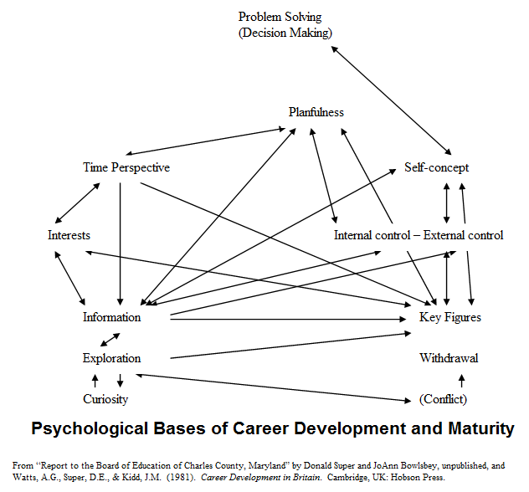
Career Maturity

Slide 12
Assumptions of Super’s Theory
Development through the life stages can be guided, partly by facilitating the maturing of abilities and interests and partly by aiding in reality testing and the development of self-concepts.
The process of career development is essentially that of development and implementing occupational self-concepts.

Slide 13
Self-Concept
“A picture of the self in some role, situation, or position, performing some set of functions, or in the web of relationships.”

Slide 14
Self-Concept
Self-concept is a product of the interaction of factors such as:
  Inherited aptitudes
  Physical makeup
  Opportunity to observe and play various roles
  Evaluation of whether role-playing meets with the approval of significant others.

Slide 15
Self-Concept
Individual acknowledges distinctive characteristics of self while simultaneously acknowledging similarities to others
Vocational decisions made are consistent with self-concept
Role playing facilitates development of vocational self-concept
Reality testing solidifies vocational self-concept
Self-concepts continue to develop over time, making career choices and adjusting to them lifelong tasks.

Slide 16
Assumptions of Super’s Theory
Work satisfaction and life satisfactions depend on the extent to which the individual finds adequate outlets for abilities, needs, values, interests, personality traits, and self-concepts.
Work and occupation provide a focus for personality organization for most men and women, although for some persons this focus is peripheral or even nonexistent.

Slide 17
Putting it together…
Everyone has unique interests, abilities, needs, etc. that can be matched to occupations.
Our career pattern is influenced by our history (parental, SES, exposure, skills, etc.).
We are constantly changing – self-concepts change as we acquire experiences in life.
Counseling process involves facilitating career maturity and aiding in reality testing (which helps develop self-concepts).
Super illustrated the wide variety of factors influencing career development as a archway…..

Slide 18
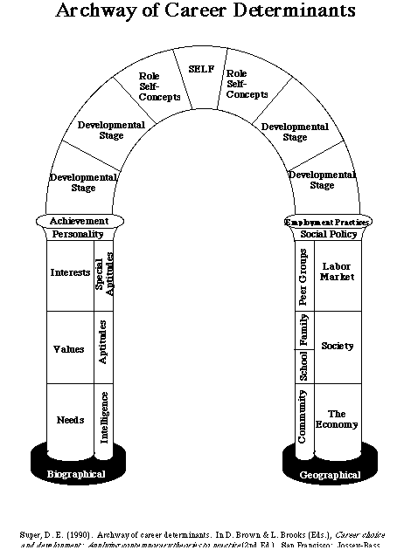
Super’s
Archway
A very comprehensive view of influences on career development.

Slide 19
Life Span
5 Stages
Growth - fantasy, interests, capacities
  Innate curiosity, fantasizing, acquiring information about interests and their own abilities
Exploration - crystallizing, specifying, implementing
  Crystallizing is clarifying the type of work they would enjoy.
  Specifying refers to making judgments about which specific jobs fit them.
  Implementing refers to taking steps toward getting started in one’s chosen field.

Slide 20
Life Span
5 Stages
Establishment - stabilizing, consolidating, advancing
  Consolidating refers to becoming a dependable worker, building a reputation
Maintenance - holding, updating, innovating
Disengagement - decelerating, retirement planning, retirement living

Slide 21
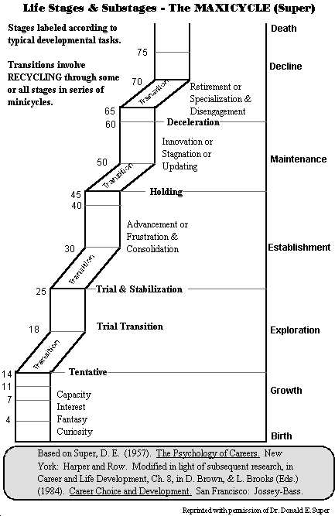
Life Span
Disengagement
As Super developed his theory, he noted that the stages repeat in cycles at transitional points. He moved to a concept of “cycling and recycling.”

Slide 22
Life Space
While workers are busy earning a living, they are also busy living a life.
The simultaneous combination of life roles we play constitutes the life style;
The sequential combination of life roles structures the life space.
The total structure is the career pattern.

Slide 23
Life Roles
People tend to play some or all of nine major roles:
  Son or daughter
  Student
  Leisurite
  Citizen
  Worker
  Spouse (Partner)
  Homemaker
  Parent
  Pensioner

Slide 24
Life Roles
The theaters for these life roles are the
  home,
  school,
  workplace, and
  community.

Slide 25
Life Space
The salience people attach to the constellation of life roles they play defines the life structure.
The life space segment of the theory acknowledges that people differ in the degree of importance they attach to work.

Slide 26
Life Span, Life Space
As the importance of various roles increases or decreases, the lifestyle changes, and decision points are encountered that have further change on the life cycle of the person.
The choices made at these decision points are influenced by a person’s life experiences, genetic endowment, and all the social, cultural, and economic conditions the individual has encountered.

Slide 27
Life Span, Life Space
For most of us, a few of our life roles dominate our life space.
  Decisions about which life roles take precedence at any given time is heavily influenced by our values.
  Life-career rainbow illustrates how all of these pieces fit together:

Slide 28
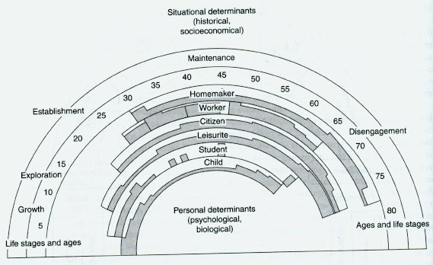
Life-Career Rainbow
Life Roles
Life Stages
Life Space:
Sequential combination of life roles
Life Span

Slide 29
Life-Career Rainbow
Clients discuss the values
they want to express in each
role, level of satisfaction in
role, what influenced the
changes in roles,
desires for
future roles.

Slide 30
Super’s Maxicycle
Recycling through some or all of the stages occurs during transitions.
In today’s environment, frequent changes in jobs (or changes within a job due to technology, etc.) will lead a person to recycle many times within a life stage (“recycling”).

Slide 31
Life Stage Matrix - Cycling & Recycling
Life Stage | Adolescence 14-25 | Early Adulthood 25-45 | Middle Adulthood 45-65 | Late Adulthood 65 & Over
Decline | Giving less time to hobbies | Reducing sports participation | Focusing on essentials | Reducing working hours
Maintenance | Verifying current occupational choice | Making occupational position secure | Holding one's own against competition | Keeping what one enjoys
Establishment | Getting started in a chosen field | Settling down in a suitable position | Developing new skills | Doing things one has wanted to do
Exploration | Learning more about opportunities | Finding desired opportunity | Identifying new tasks to work on | Finding a good retirement place
Growth | Developing a realistic self-concept | Learning to relate to others | Accepting one's own limitations | Developing and valuing nonoccupational roles

Slide 32



Exercise: Life Span Matrix
Super moved from stages to cycles because cycling and recycling better described life.
How has your life cycled and recycled? Project into the future, beyond your current age.
Life Stage | Adolescence 14-25 | Early Adulthood 25-45 | Middle Adulthood 45-65 | Late Adulthood Over 65
Deceleration
Maintenance
Establish.
Exploration
Growth

Slide 33
Career Development and Assessment (C-DAC Model)
Super and his colleagues translated the three segments of the theory into the C-DAC Model.
Assessments used in the model include
  Career Development Inventory
  Adult Career Concerns Inventory
  Salience Inventory
  Values Scale
  Self-Directed Search

Slide 34
Super’s Thematic Extrapolation Method
Addresses subjective career development
Gives counselors the role of historians who invite clients to construct autobiographical stories of development
Life stories are examined for recurrent themes or threads of continuity that make sense of the past, explain the present, and draw a blueprint for the future.

Slide 35
Steps in the Thematic Extrapolation Method
Step 1: Analyze past behavior and development for recurring themes and underlying trends.
Step 2: Summarize each theme and trend, taking into account the other themes and trends.
Step 3: Project the modified themes and trends into the future by extrapolation.

Slide 36
Steps in Super’s Cyclical Model of Career Counseling
Nondirective problem exploration and self-concept portrayal (client tells his story)
Directive topic setting (clarify focus of counseling)
Nondirective reflection and clarification of feeling for self-acceptance and insight (basic counseling skills)
Directive exploration for factual data
Nondirective exploration of attitudes and feelings
Nondirective consideration of possible actions

Slide 37
Some interventions from Super’s Model
Discussing the life-role
  Assist clients in gaining self-awareness
    Reflect on their life-roles (past and present)
    Which are most important? Why?
    How do the various life-roles interact with each other?
      Do they support each other, interfere with each other, compliment each other?
      How do you feel about each of these life roles? Which roles do you enjoy or look forward to playing? Why? Are there roles you dread or fear? Why?

Slide 38
Some interventions from Super’s Model
Discussing the life-role
  Assist clients in being able to adapt to the demands of multiple life roles
    How do I spend my time in a typical week?
    What activities do I engage in for each life role?
    Which life roles/activities are more important to me?
    What are the possible consequences of playing several intense roles simultaneously? Of playing only one or two roles.
    Is the way I’m currently spending my time congruent with my desires?
    What life roles will I be playing in the future

Slide 39
Some interventions from Super’s Model
Discussing the life-role
  Assist clients in understanding the role of culture in the salience of their life-roles
    Influence of the dominant culture (sometimes we just inherit the role expectations present in the dominant culture without much reflection)
    Influence of the culture of origin (how does our personal culture influence our various role expectations?)

Slide 40
Some interventions from Super’s Model
Super emphasizes planning
  Planning reflects awareness, which is the first step in coping with the developmental tasks at any stage.
    Portfolios - a tool to encourage planning behaviors
      Interests, activities, hobbies
      Future plans
      Information (from inventories, online searches, etc.)
      Tools (resume, etc.)

Slide 41
Super’s Theory
Empirical Evaluations
  Difficult to establish empirical support due to the broad nature of the theory
  Osipow and Fitzgerald (1996) and Hackett, Lent, and Greenhaus (1991) support Super’s theory in general

Slide 42
Donald Super -
Not just a developmental theory
Super’s theory incorporates concepts from a wide variety of perspectives:
Trait & Factor
Developmental
Social Learning
Narrative
Values-Based

Slide 43

Donald Super
Using Super’s theory, what issues would be important in counseling Tai-Linn?
What might the counseling process look like?

Slide 44
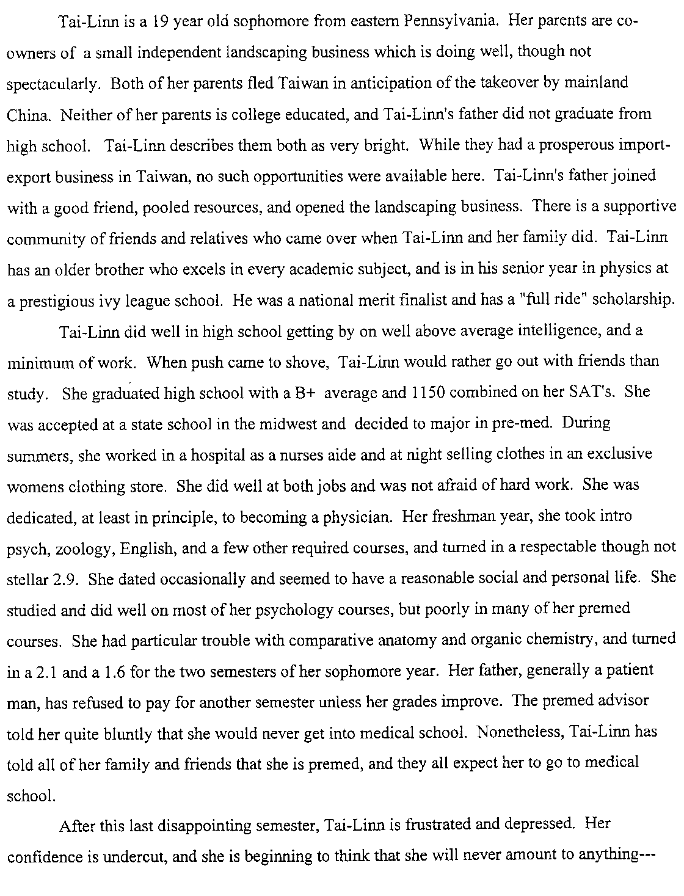



Slide 45
Linda Gottfredson
Circumscription, Compromise, and Self-Creation
Addresses the fact that men and women tend to differ in their occupational aspirations
Offers a developmental, sociological perspective of career development
Focuses primarily on the career development process as it relates to the types of compromises people make

Slide 46
Linda Gottfredson
Circumscription – Process of eliminating unacceptable occupational alternatives based primarily upon gender and prestige
Guided by 5 principles
  Children capable of understanding and organizing complex information
  Occupational preferences reflect attempts to implement and enhance self-concept
  Children integrate complex distinctions among people (prestige) while integrating the more concrete phenomena (sex roles)
  Children progressively eliminate occupational options as self-concept complexity and clarity increases
  Process is gradual and not readily obvious

Slide 47
Linda Gottfredson
Principles operate throughout 4 cognitive stages which describe process
  1. Orientation to size and power (preschool)
Big, powerful
Adult roles
Parent, worker
Little
Child

Slide 48
Linda Gottfredson
  2. Orientation to sex roles (elementary school)
Male
Female
Firefighter
Truck Driver
Doctor
Nurse
Teacher
Secretary

Slide 49
Linda Gottfredson
  Orientation to social valuation (middle school)
High Prestige
Doctor
Teacher Nurse
Firefighter
Secretary
Truck driver
Low Prestige
Male Female

Slide 50
Linda Gottfredson
  4. Orientation to internal, unique self
I
Doctor
Sales
Manager
E
R
Miner
S
Social Worker
File Clerk
C
A
Artist

Slide 51
Linda Gottfredson
Compromise – Modifying occupational choices in light of limiting factors, whether internally or externally imposed
  Tolerable-effort boundary
  Tolerable-level boundary
  Tolerable-sextype boundary
  Zone of acceptable alternatives

Slide 52
Linda Gottfredson
High
Surgeon
Psychiatrist
Federal Judge
Tolerable-Effort Boundary
High School Teacher
Elementary Teacher
Prestige
Zone of Acceptable Alternatives
Real Estate Agent
Nurse
Tolerable-Sextype Boundary
Receptionist
Tolerable-Level Boundary
Construction Worker
Low
Masculine
Feminine
Sextype Rating

Slide 53
Linda Gottfredson
Self-Creation – Included in circumscription process; altering self-concept in light of developmental or environmental factors

Slide 54
Applying Gottfredson’s Theory to Practice
Programs should
  be sensitive to the mental capabilities of the age group.
  introduce students to the full breadth of options.
  display for youngsters their circumscription of alternatives.
  be sensitive to the dimensions of self and occupations along which circumscriptions and compromise take place so that their role can be explored.

Slide 55
Gottfredson’s Criteria for Determining a Counselee’s Restriction of Options
Able to name one or more occupational options
Possesses interests and abilities adequate for the occupation(s) chosen
Satisfied with the alternatives identified
Has not unnecessarily restricted alternatives
Is aware of opportunities and realistic about obstacles

Slide 56
Counseling Strategies
Developmental Process | Behavior to be optimized | Strategies | Elem. School | Middle School | High School & Beyond
Cognitive Growth | Learning | Reduce task complexity, accommodate cognitive diversity | Short, concrete tasks | Tasks requiring relating ideas and making inferences | Tasks requiring analysis & integration of information
Self-Creation | Experience | Provide experience and promote self-agency | Field trips, career days, contact with workers, portfolios | Examples from current events, novels, biographies. Simple jobs, extracurricular activities | Broad range of courses, community service, job shadows, internships, clubs, summer jobs
Circumscription | Self-insight | Facilitate inventory and integration of info about self, promote conception of fitting & feasible career life |  | List tentative life goals, strengths, weaknesses, family expectations, barriers, which jobs they reject and why | Assessments of interests, abilities, values, personality, etc. Analyze supports, barriers, person/job match, setting goals
Compromise | Self-investment | Facilitate assessment of accessibility of preferred career, promote self-agency |  |  | Training in interviewing, resumes, job search skills, building support, enlisting mentors

Slide 57
Linda Gottfredson
Little research has been done on the theory
Most research has been on circumscription, and tends to support that part of the theory
Difficult to research because the concepts of circumscription and compromise are too general

Slide 58

How does Tai-Linn’s problem fit into Gottfredson’s theory?
High
Surgeon
Psychiatrist
Federal Judge
Tolerable-Effort Boundary
High School Teacher
Elementary Teacher
Prestige
Zone of Acceptable Alternatives
Real Estate Agent
Nurse
Tolerable-Sextype Boundary
Receptionist
Tolerable-Level Boundary
Construction Worker
Low
Masculine
Feminine
Sextype Rating

Slide 59
Exercise
Occupational Prestige Exercise

Slide 60
Tiedeman and O’Hara
Influenced by work of Ginzberg and Super
Career development is a process of organizing an identification with work through interaction of individual’s personality with society.
Career development is a lifetime process
One’s vocational patterns must be fit into large life pattern, or else they dominate.

Slide 61
Tiedeman and O’Hara
Decision is the crucial factor in career development.
  Decisions form and structure career development.
Each decision has two aspects:
  Anticipation
  Implementation and Adjustment

Slide 62
Tiedeman and O’Hara
Anticipation is subdivided into the following substages:
  Exploration
  Crystallization
  Choice
  Specification or clarification

Slide 63
Tiedeman and O’Hara
Implementation and Adjustment is subdivided into the following substages:
  Induction
  Transition
  Maintenance

Slide 64
Tiedeman and O’Hara
The process is reversible; it cycles as one is faced with complex decisions.
Person may be at varying stages with a variety of decisions at a given time.

